Slide 1
Chapter 1 What is Sport and Why Do We Study It?
C H A P T E R
31
Project Risk Management

Slide 2
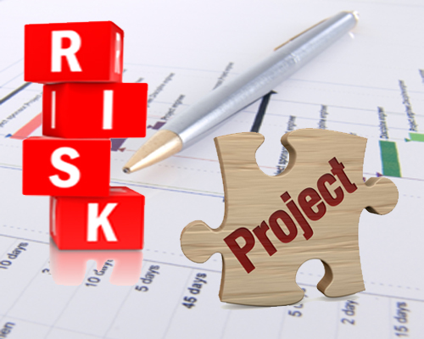
Introduction to Project Risk Management
Project risk management is about delivering the project on time, within budget and to quality
It is concerned about the risks embedded within delivery of the project

Slide 3
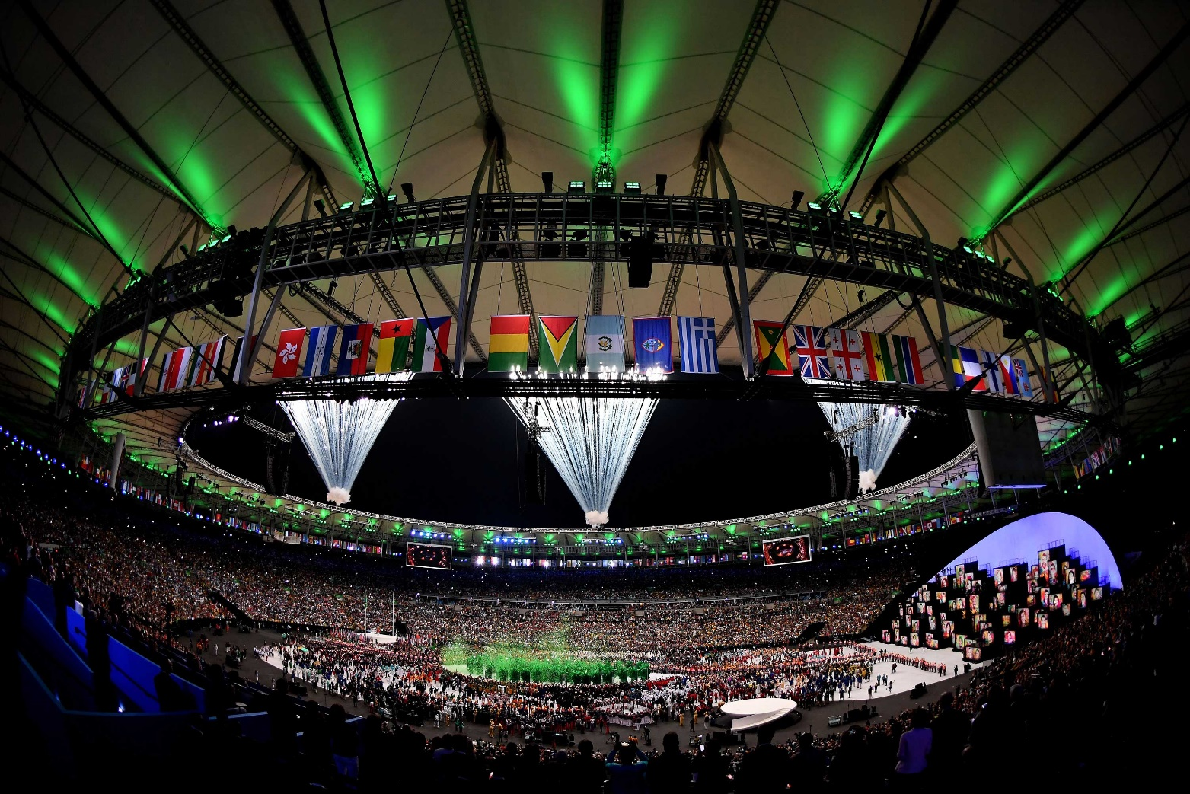
What are the risks of hosting the Olympics?

Slide 4
Development of Project Risk Management
Compliance, hazard, control and opportunity risks need to be considered as part of the successful management of any project
  Compliance: obtaining necessary permissions and approvals
  Hazard: risks that prevent the project from being delivered on time and within budget
  Control: risks concerning the specification, performance and quality of the final outcome
  Opportunity: risks that can enhance the delivery of the project

Slide 5
Uncertainty in Projects
A risk register should be populated and updated regularly throughout the duration of the project
The register needs to be reviewed regularly
  The internal and external project environment is continually changing
The register must be continually updated and reports generated at regular intervals
  Management reports should provide clear visibility on the risks faced, enable prioritization of the activity and facilitate decision making

Slide 6
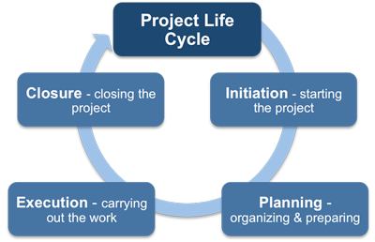
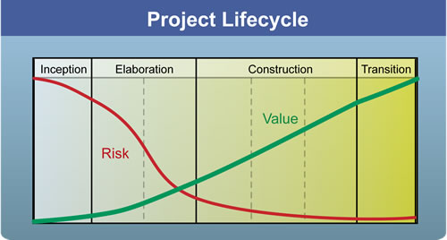
Project Lifecycle

Slide 7
Project Lifecycle
Building a house
Survey the land
Outline the costs
Design the blueprints
Schedule the work
Building
Budget & quality progress checks
Delivery to the buyers
Final walk through

